Slide 1






Learnings and opportunities for scaling
CLCA virtual workshop,
ITGC 31 March, 2022
Louahdi Nasreddine
National coordinator – ITGC Algeria
IFAD – ICARDA - CIMMYT GRANT PROJECT
“Use of conservation agriculture in crop-livestock systems (CLCA) in the drylands for enhanced water use efficiency, soil fertility and productivity in NEN and LAC countries”

Slide 2
CLCA Evolution in Algeria …10 years of work
End of Phase I
June 2016
CLCA
Interphases
Year 02
Year 04
Platforms : 6
Trials : 242
Area : 982 ha
Farmers : 242
Seeders : 24
Platforms : 10
Trials : 621
Area : 2335 ha
Farmers : 723
Seeders : 39
Continuity of Long term trials
2012
2018/2019
2020/2021
2016
2018
2019/2020
2021/2022
CLCA
Phase I
Year 01
Year 03
Phase II
June 2018
Platforms : 3
Trials : 36
Area : 316 ha
Farmers : 36
Seeders : 18
Platforms : 10
Trials : 500
Area : 1500 ha
Farmers : 492
Seeders : 38
Prospecting and experimentation phase in 30 trials

Slide 3
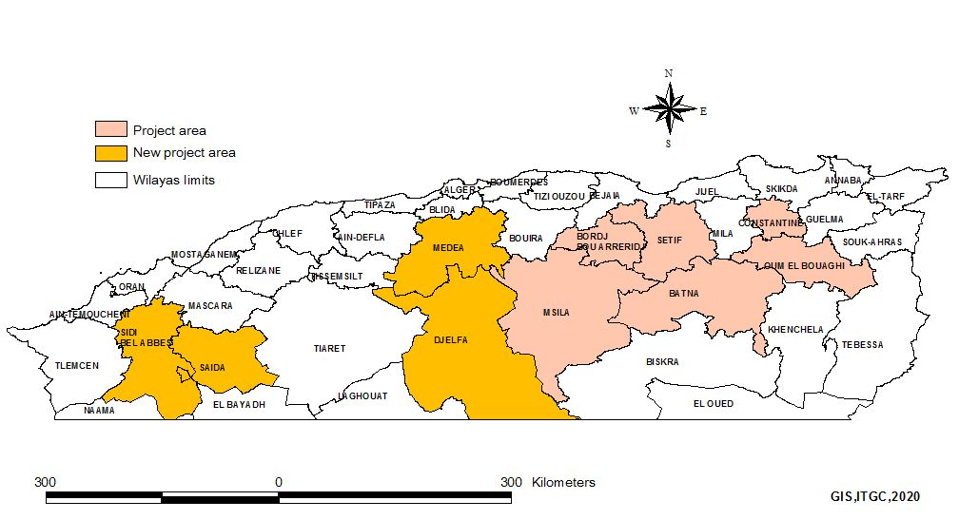


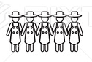
YEAR IV – 10 platforms
621 with 12 reference sites
2335 ha directly affected
723 Farmer s directly involved
38 women involved
39 ZT Seeders (20 local)
10%
2153 Farmers indirectly affected by the project activities
170 women affected

Slide 4
Best agronomic packages ( CLCA innovations)
1- CA as a way to reduce water loss
irrigation in irrigated areas.
1
2 – Oat vetch or Triticale vetch is the best mixture, and vetch is the specie that produces more biomass.
2
3 – The disc seeder retains more water, but with tines ensures better performance.
3
4 – A late total weed control strategy with a dose between 540 -720 g / ha ensures good control, followed by a weed control of early catching up.
4
5 – The lentil is the best precedent, followed by vetch.
5
6 – Grazing management according to the method recommended by the ITELV.
6

Slide 5
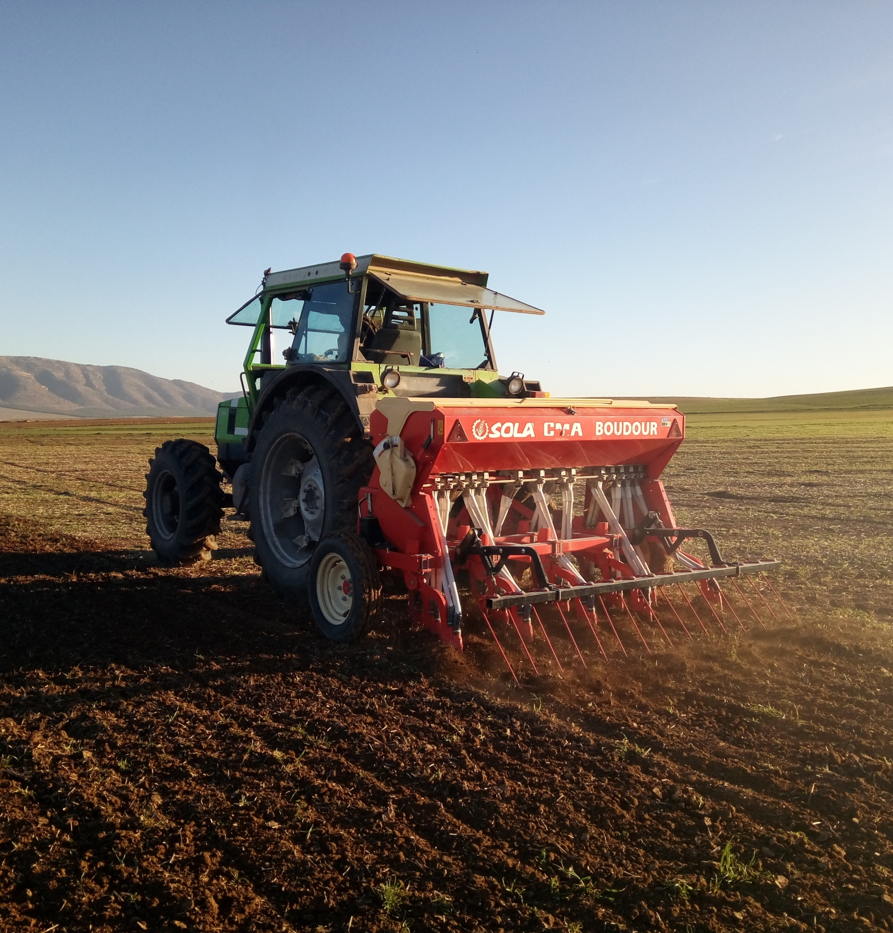
Low cost ZT seeder - BOUDOUR
BOUDOUR seeders for sale to farmers and cooperatives
A low cost ZT seed drill
( 13 000 $ ) supported at 30% ( 9 100 $ ) and 40 % ( 7 800 $)
Acquisition by farmers and launch of provider services ( ZT and conventional seeding).

Slide 6
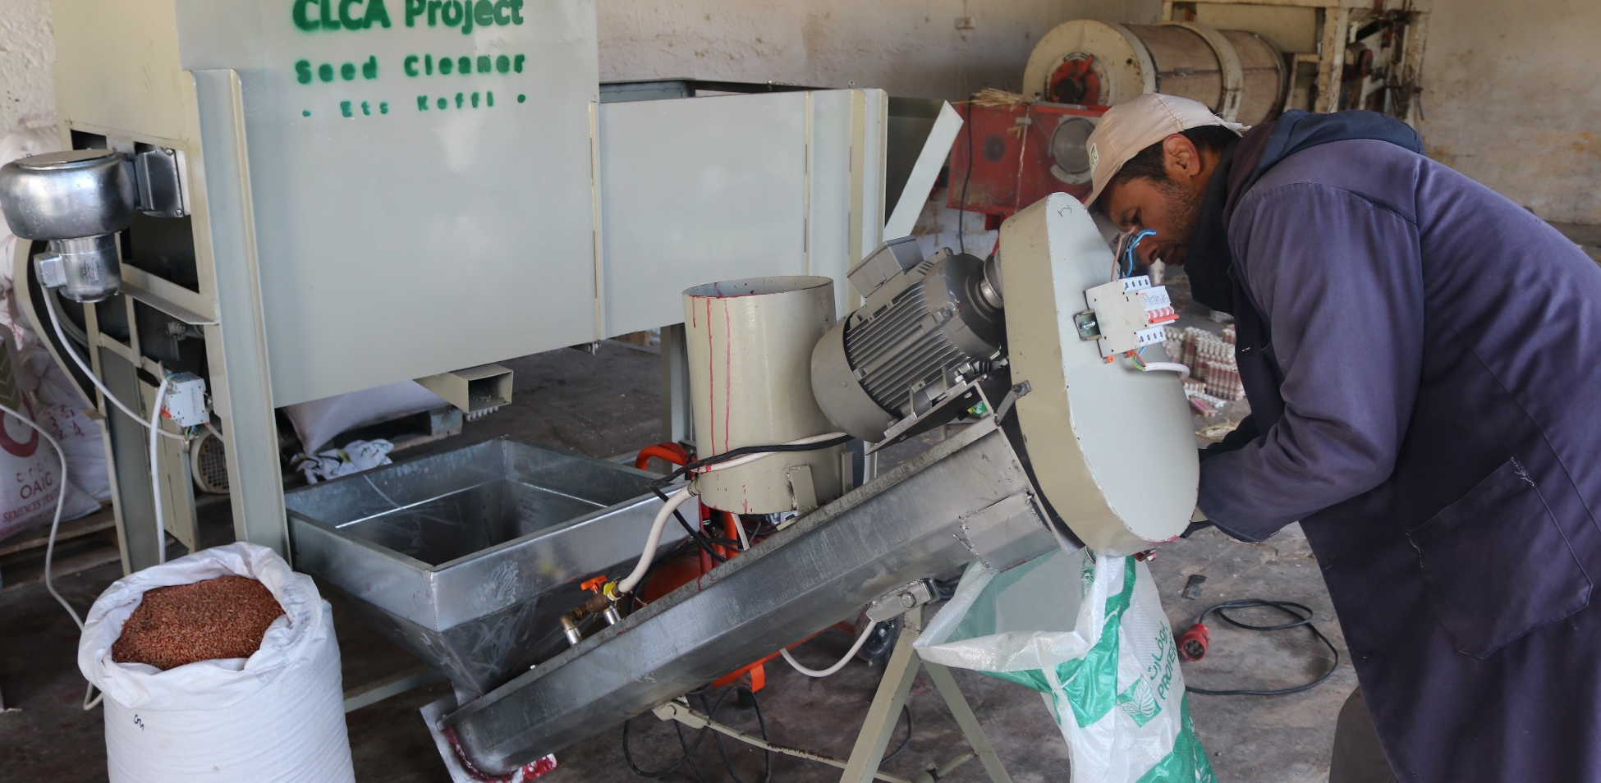
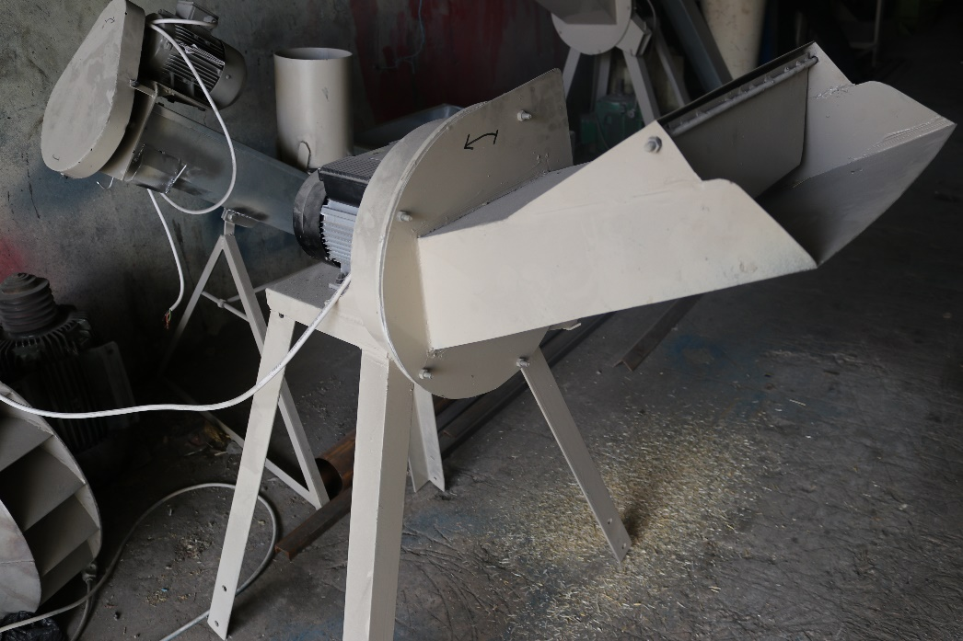
Low cost, locally manufactured seed cleaning unit to minimize production costs.
Cost: 2000 USD
Photo : Zied Idoudi (ICARDA)
Development of small mechanization
Straw chopper for household use by women to improve fodder quality
Cost: 550 USD

Slide 7
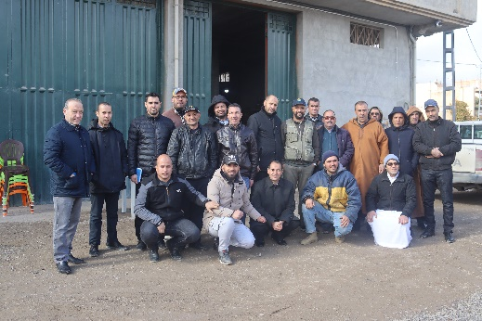
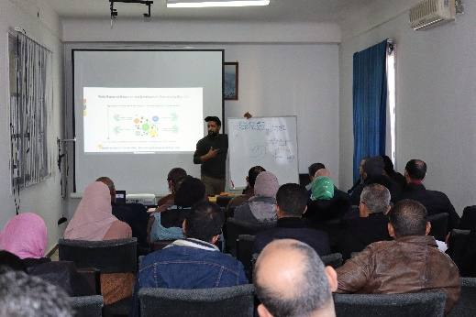
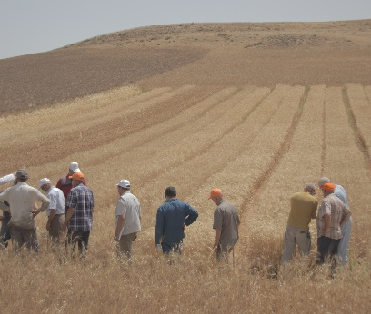
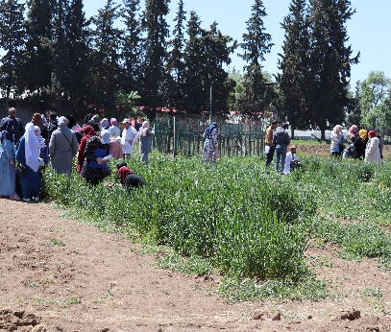
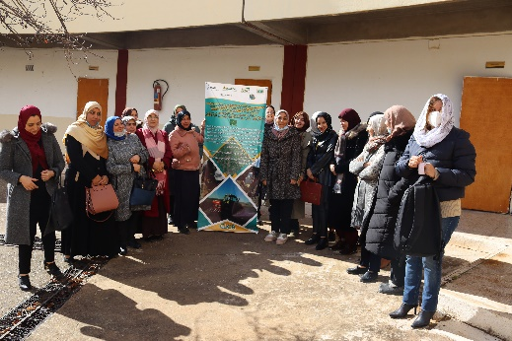
Training of farmers, technicians and students in 04th year
42 local and regional events that indirectly affected 1194 farmers and technicians
31 students (master and doctorate) follow the project activities.
01 field trip with Mr Zied Aidoudi (ICARDA Tunis) which involved 140 executives from the project partners (Dec.2021).
02 Online training courses on CA and livestock with ICARDA
02 stickers for machines for farmers
01 chapter book

Slide 8
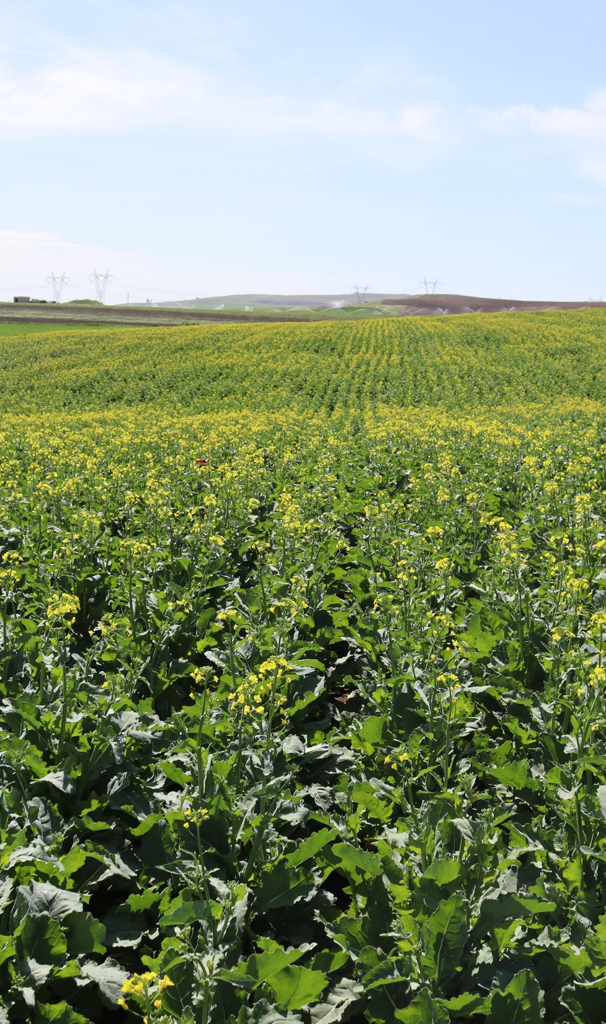
Introduction of the CLCA package in the national Canola program.
Canola under CA
A total area of 180 ha under AC.
Use of the ZT seeder to sowing Canola , for better sowing quality.

Slide 9
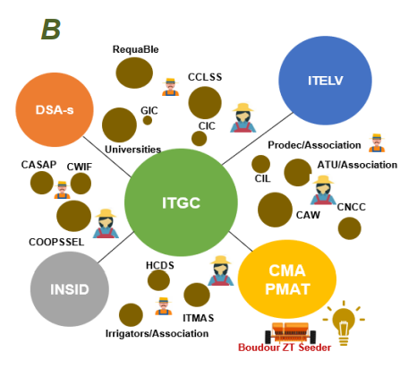
Typology of scaling actors according to “4 Wheels approach” for partnership
More than 19 partners and institutions involved in the project
Farmers
Beneficiary
Farmers’ associations
& Civil Society
Private Sector
Farmers
Farmers
Beneficiary
NARES Partners
Leader Farmers (Extensionists)
Beneficiary
Farmers
The R4D CLCA Project team continue to capitalize knowledge about CLCA systems:
Need for a more Decentralized Knowledge Management Approach
Ref : Aymen Frija, Zied Idoudi, https://hdl.handle.net/20.500.11766/12248

Slide 10
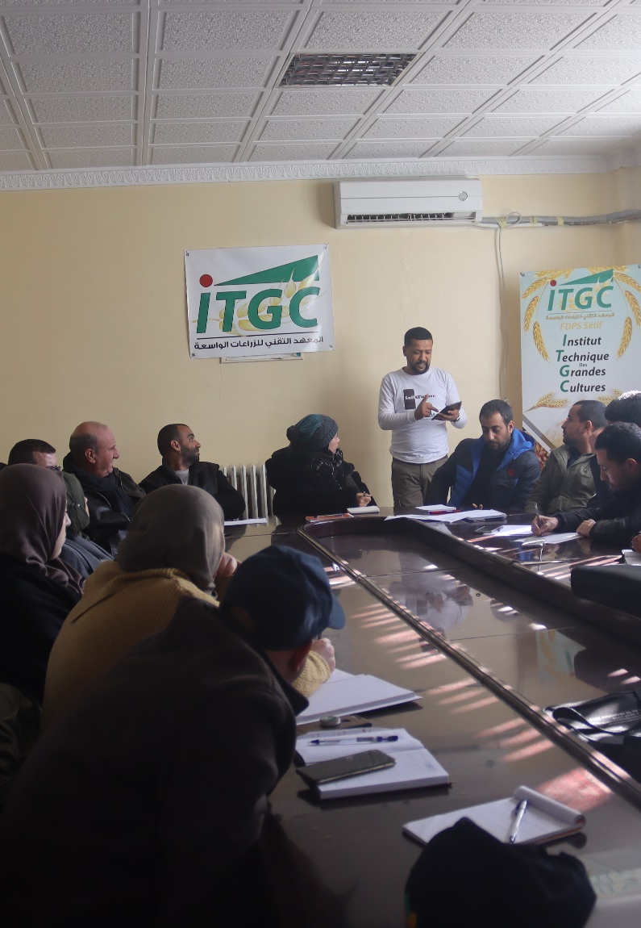
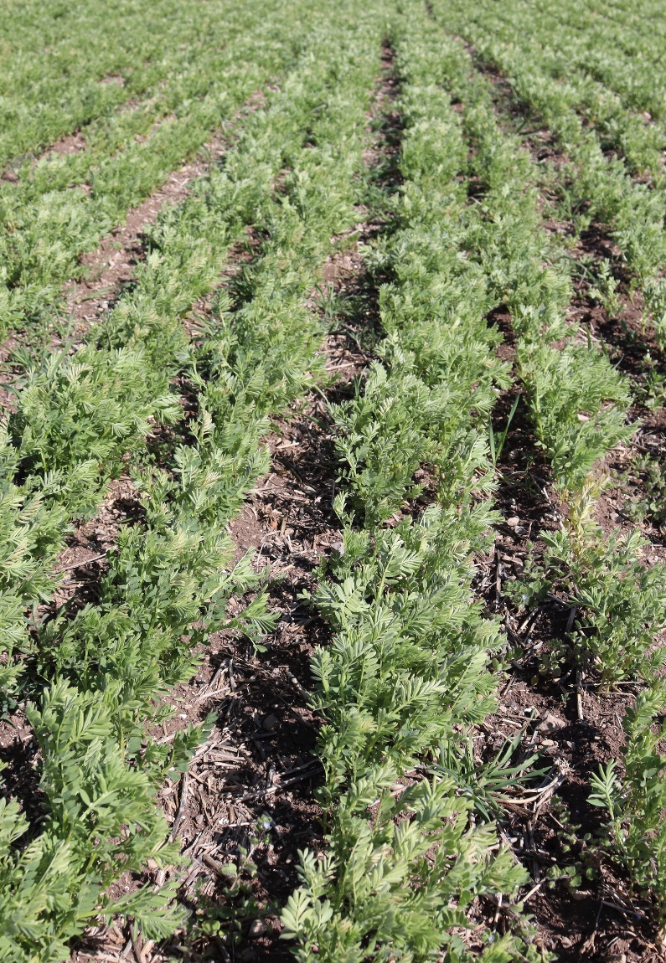
Preparation of the post-project phase by installing two K.Hubs
AC - K. Hubs
In ITGC Sétif which brings together the partners involved in the development of CA.
Forages- K. Hubs
In ITELV Ain M'lila which brings together the partners involved in the development of forage crops.

Slide 11
Diffusion through medias
facebook.com/ItgcSetif/ : 18 433 total subscribers
facebook.com/ALGERIACLCAPROJECT/ : 1033 total subscribers
Twitter : Algeria CLCA Project
Text Here
Data SIM Application : SMS service for 600 farmers and managers, 15% of whom are women
02 short videos on the project and 02 for weed control and harvest loss in preparation
05 Radio broadcast on local and national radios

Slide 12



Year 01
Year 02
Year 03
Year 04
Station and sites
36
farms
242
farms
492
farms
(1500 ha)
723
farms
(2335 ha)
Feedback
1010
Farmer and Tech.
2500
Farmer and Tech.
SCALING STRATEGY
Notes:
© Copyright PresentationGO.com – The free PowerPoint template library

Slide 13
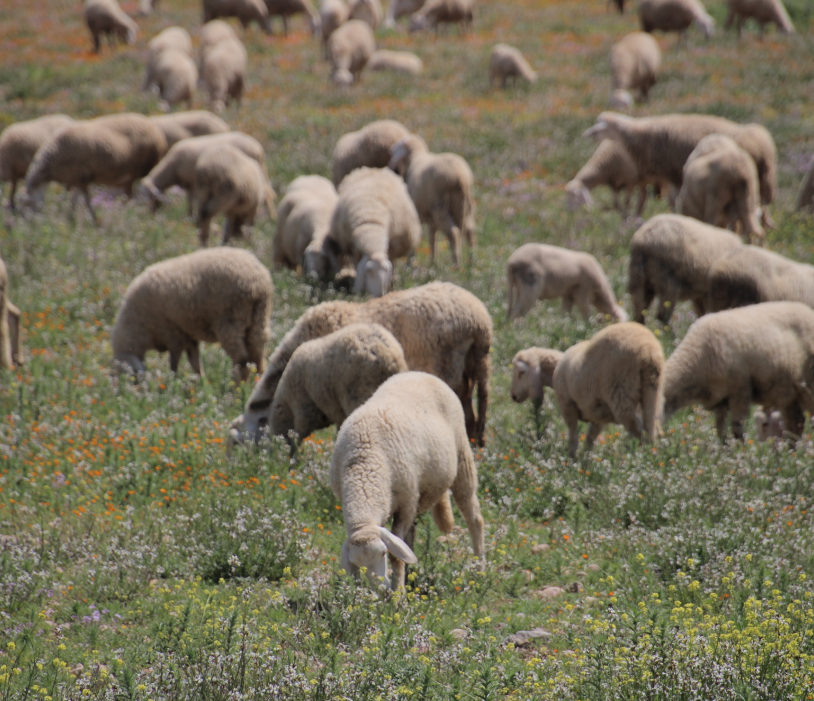
Thank You

